Slide 1
InSYNC sURVEY Analysis
Skylar Carman

Slide 2
Overview
1.Review of Quantitative Analysis
2.Qualitative Analysis

Slide 3
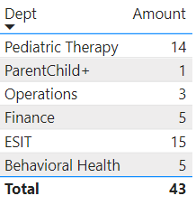
Participation by department

Slide 4
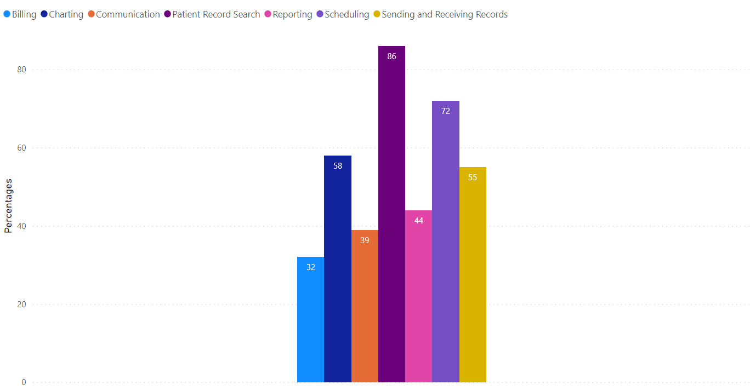
Primary uses
%
%
%
%
%
%
%

Slide 5
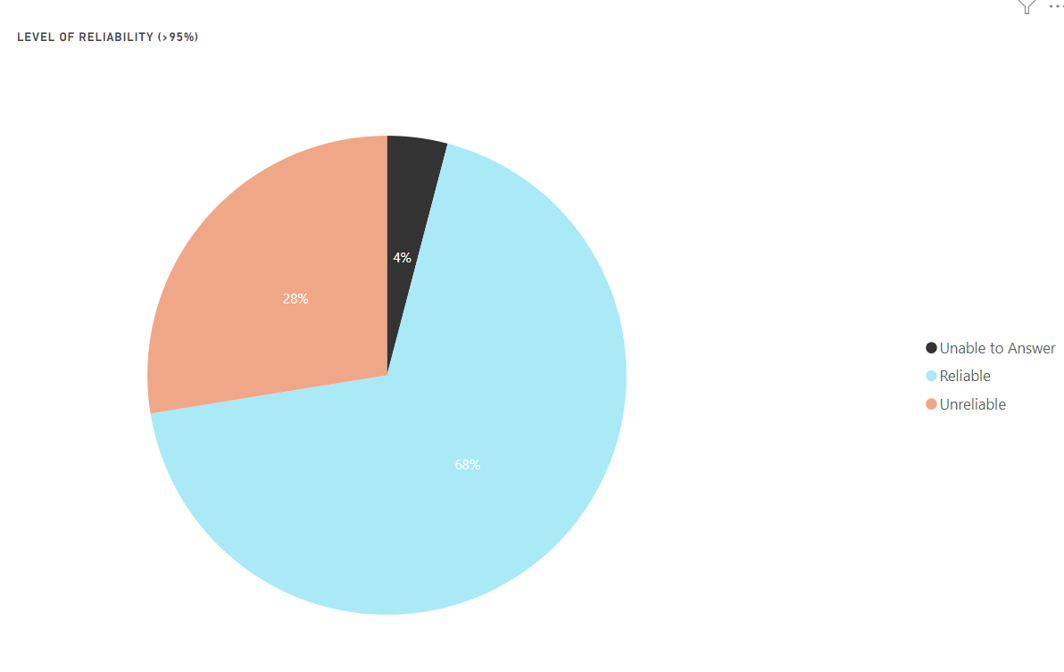
Overall reliability RATIO

Slide 6
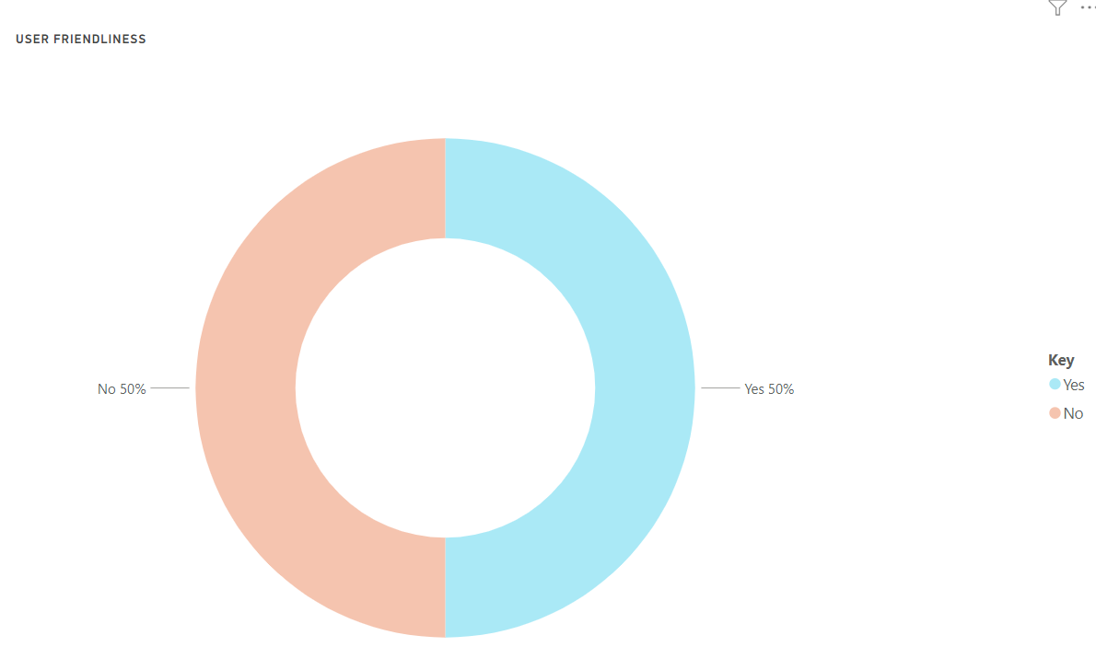
User Friendliness

Slide 7
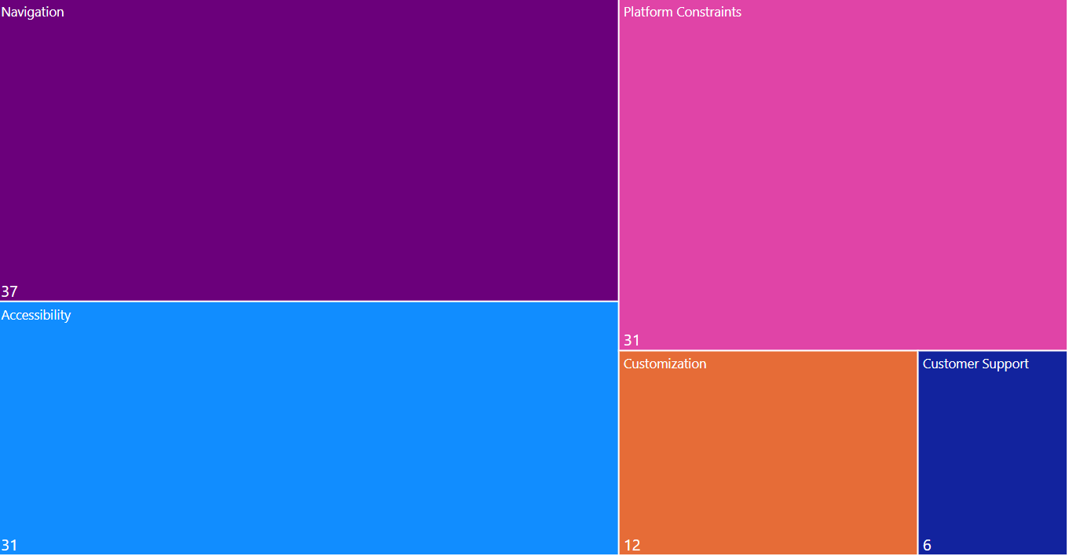
*Multiple selection question
CONSTRAINTS TO USER FRIENDLINESS
%
%
%
%
%

Slide 8
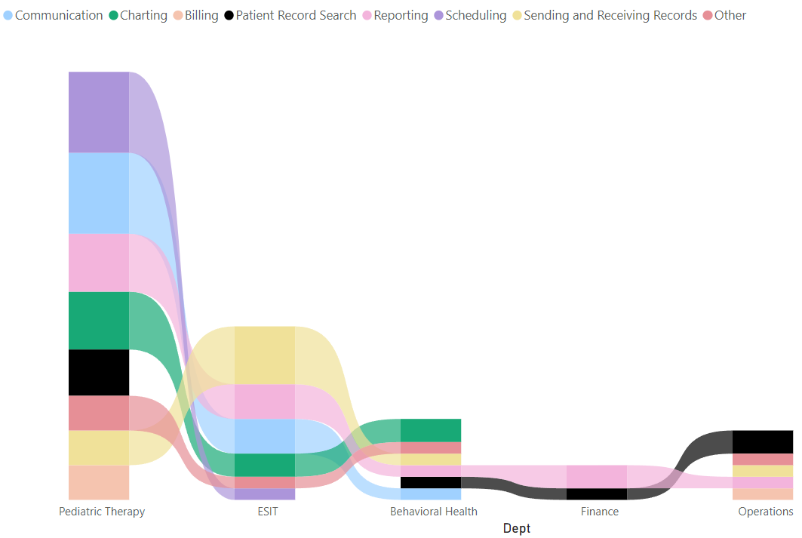
DESIRED IMPROVEMENTS BY DEPT

Slide 9
OVERALL rATINGs
By Department: 5.7/10
Individual: 6.3/10

Slide 10
Qualitative Analysis
What are the features in InSync that you would like to keep?
What features in other EHRs would you like to see in InSync?
Regarding the desired improvements, how should they be improved/ what about them should be improved?
What would make InSync a 10/10 and why?
Additional Comments?

Slide 11
THANK YOU
Skylar Carman
Skylar.carman@bellevuecollege.edu
Skylar.carman@encompassnw.org
BC Healthcare Informatics

